Slide 1
Simulation 030909
(s2=0.05)
Deconv L1+TV

Slide 2
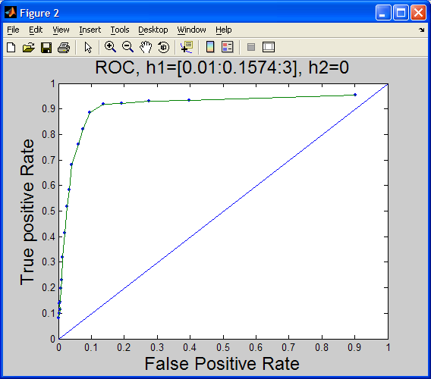
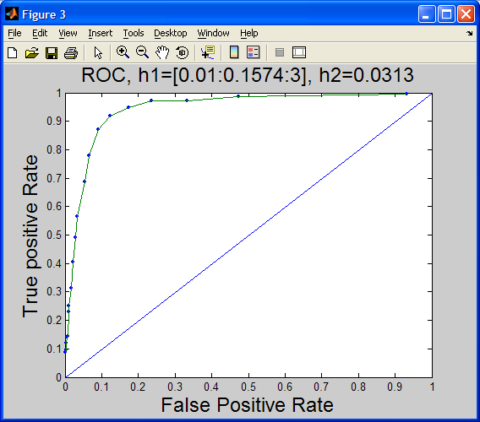

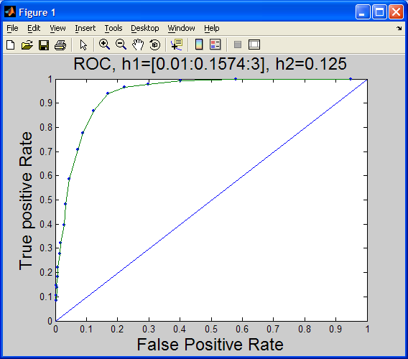

Slide 3

